Slide 1
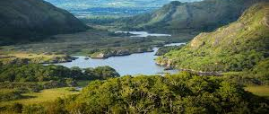
Co. Kerry
By Leia Rehault

Slide 2
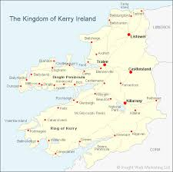
Content
Tom Crean
The Ring of Kerry
The Puck Fair
Carrauntoohil
Gaelic Football

Slide 3
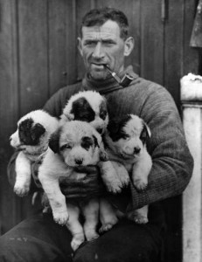
Tom Crean
Tom Crean was an Irish seaman and Antarctic explorer, Tom Crean was part of three expeditions to Antarctica. The RRS Discovery, Terra Nova and the Endurance. Tom Crean started his first adventure in 1901 on the Discovery with Captain Scott, He and his crew sailed across the Southern Ocean and Antarctica. His second expedition on the Terra Nova (which means 'New Land') Tom Crean saved his commander, Edward Evans by walking 35 miles in 18 hours, with only three biscuits and two sticks of chocolate.
His third, and last expedition was on the Endurance. The ship was stuck in ice for 10 months, there were 6 dogs aboard the Endurance VERY SADLY all of them were killed to be eaten by the crew members...
Facts
* Tom Crean was born on February 16th 1877
* He died at 61, in 1938 July 27th
* Tom Crean had a pet rabbit

Slide 4
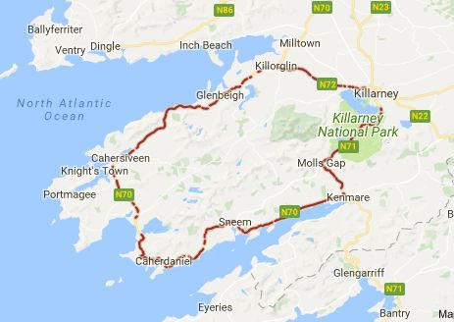
The Ring of Kerry
The Ring of Kerry is one of Ireland's most scenic coastal drives. Charming fishing villages, waterfalls, and beaches line the coastline of this peninsula in County Kerry.
This circular route is around 111 miles (179km) long. When driving without stopping, the Ring of Kerry takes three and a half hours to complete. But most people there make multiple stops, as it's the only way to soak up the beauty in Kerry's towns and villages. If you were to walk the entire route you would be there for around nine days (Although I don't think you would!)

Slide 5
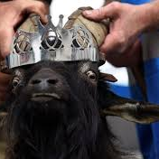
The Puck Fair
The Puck Fair is one of Ireland's oldest fairs, it starts on the 10th of August and ends on the 12t.In Killorglin Co. Kerry a wild mountain goat is crowned King. The Queen puck is traditionally a local school girl. The goat is usually treated like a king. But the goat is put into a small cage, which will be on higher ground up high. After three days the goat is brought back down, and is brought back to the mountains. People come from all over Ireland to see the Puck Fair, it lasts for three days. The first day is known as 'The Gathering' Day two is called 'Fair Day' third and final day is called 'scattering' Day.
The first day is the goats coronation, He is crowned Puck King and then put in his cage. Second day, he stays there, until the final day where he is sent back to the mountains. The Puck fair in Gaeilge is Aonach na Phoic, which means 'Fair of the He-Goat.'

Slide 6
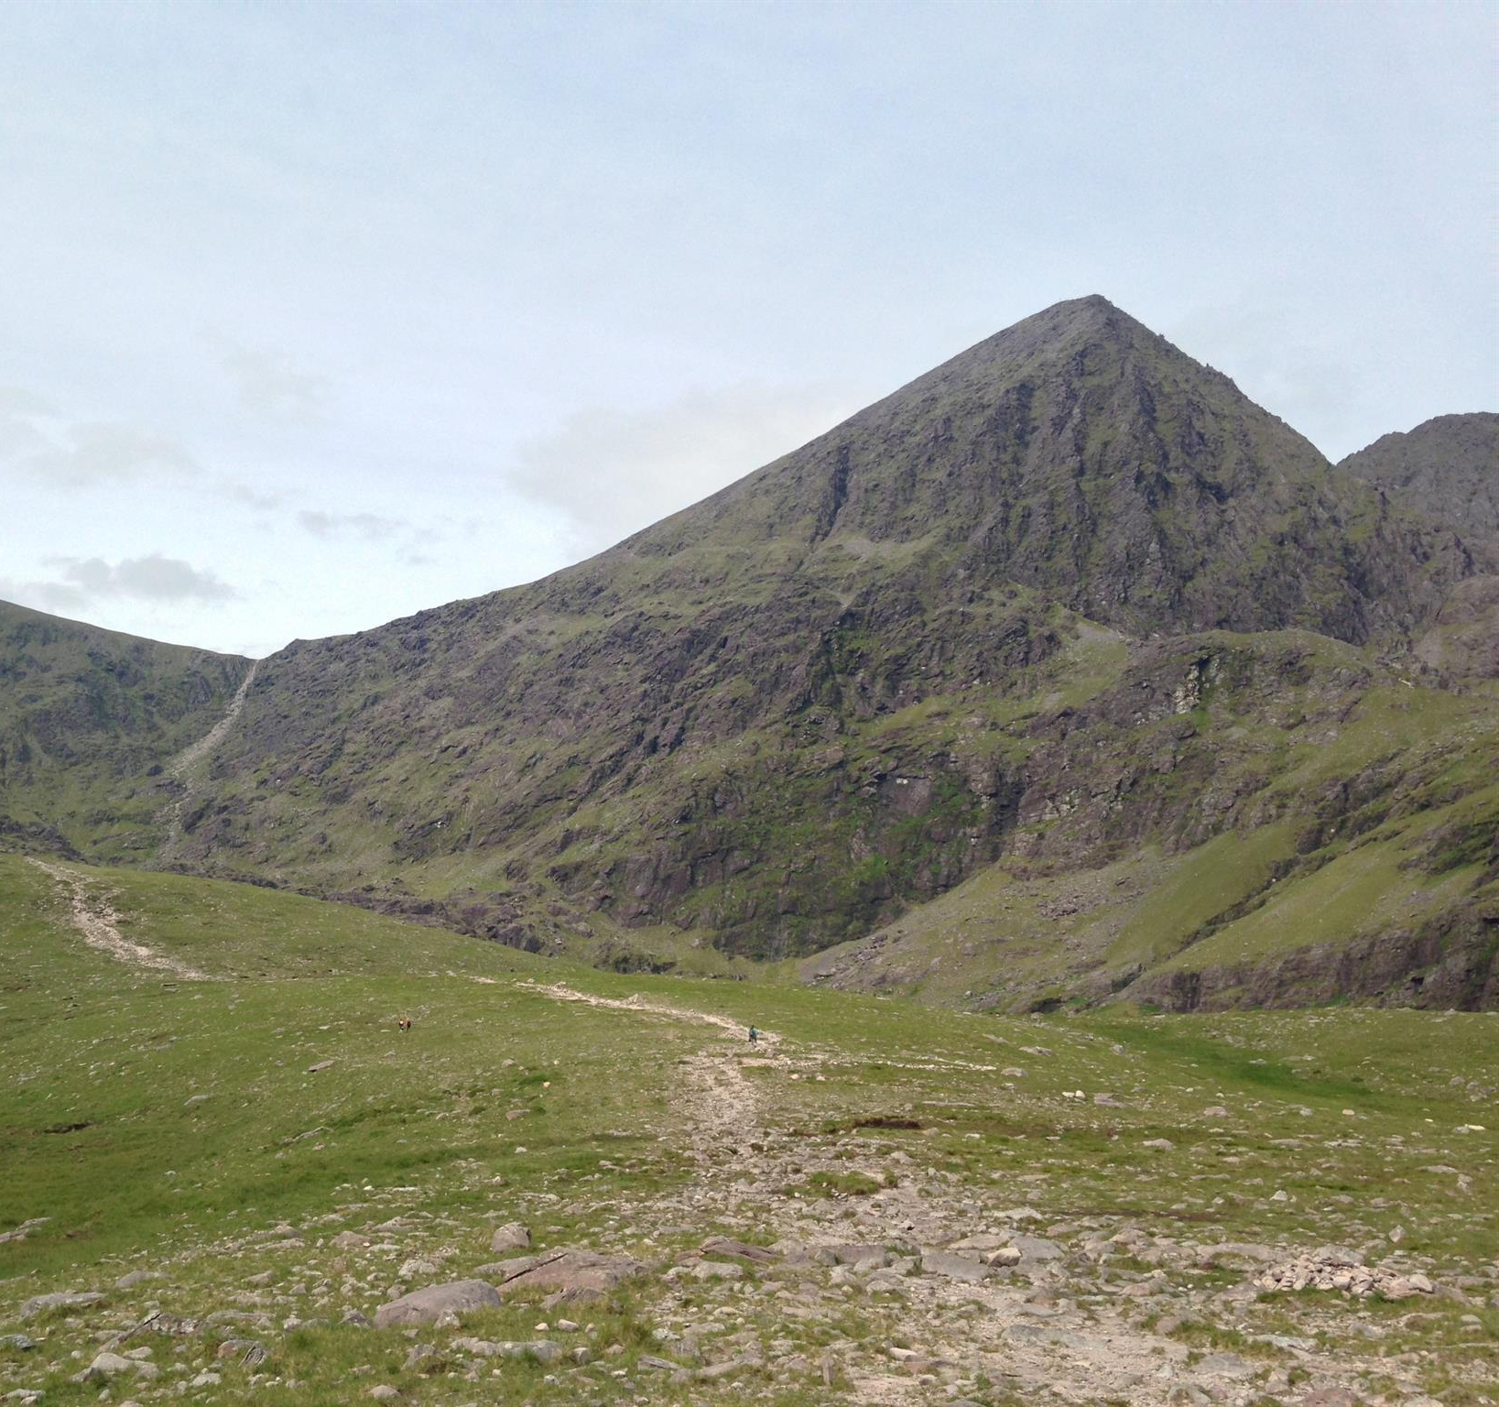
Carrauntoohil
Carrauntoohil or Corrán Tuathail is the tallest mountain in Ireland, It currently stands at 1,038.6 meters. Sadly more then 40 people have died or been hurt while climbing Carrauntoohil. Carrauntoohil is located in Macgillcuddys Reeks a mountain range in Kerry.
Lots of people would say Carrauntoohil isn't dangerous but considering over 40 people have died climbing it, it is! Another reason why it's not very safe to climb, is also because the summit itself is surrounded by steep ground. (So if you ever go climbing it, BE CAREFUL!!!)
Did you know these facts?
* Killarney is the closest town to Carrauntoohil
* It takes about 23 to 30 minutes from Killarney to Carrauntoohil
* It takes up to between 4 to 6 hours to climb Carrauntoohil

Slide 7
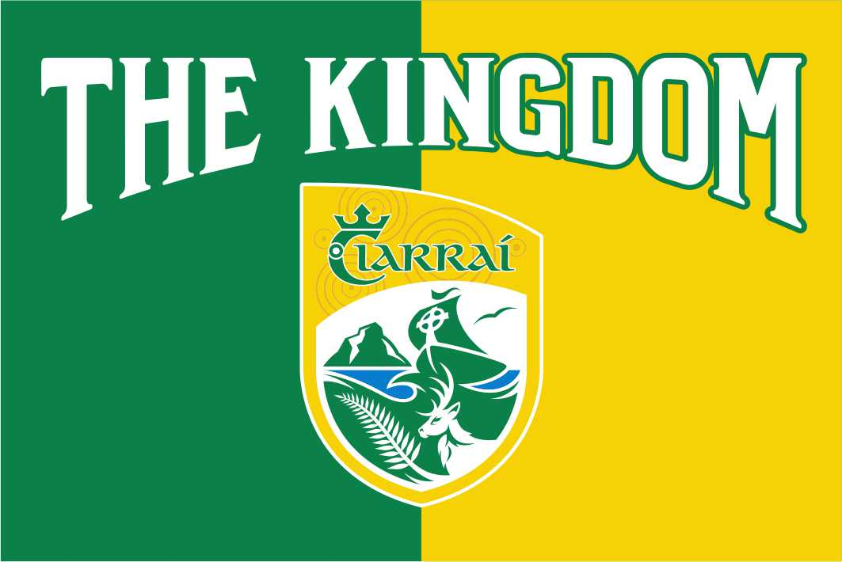
Gaelic Football
The most popular sport in Kerry is 100% Gaelic football
Kerry take their Gaelic football very seriously, they are the most successful team in the history of Gaelic football. Kerry proudly holds the record of winning the most All-Ireland championships, so far they have won 38!
Some say, the rivalry in Gaelic football is Cork and Kerry (which is sadly, is what I thought) BUT it's actually Dublin and Kerry. Ever since 1892 Dublin and Kerry have been rivals in Gaelic football, Its considered to be one of the biggest rivalries in Gaelic games... It was the first meeting between Dublin and Kerry, Dublin won. No one knew the rivalry between both sides would grow into something massive over the years and decades ahead.
Which team do you think is better?

